Slide 1

The Trade: Paul vs. Westbrook
NBA DATA ANALYSTS:
'Sanjay Suresh', 'Mitsuko Kitazawa', 'Nicolas Gomez Bustamante', 'Nicholas Keller'

Slide 2
Agenda
About the Trade project
Data source & Analysis approach
Results
Conclusions

Slide 3


About the Trade project
This off-season:
Chris Paul (HOU) was traded to the Thunders (OKC)
Russel Westbrook (30 years old) will join Houston Rockets
The objective of our project:
analyze the trade by comparing both players
determine who is the best asset for the team

Slide 4
Data source used & Analysis approach
The statistical analysis used an API from the NBA website: nba_api.stats (no key needed)
Comparative analysis used career stats:
- for Westbrook and Paul
- data from 2005 to 2018

Slide 5
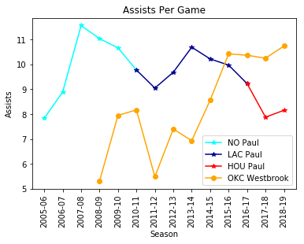
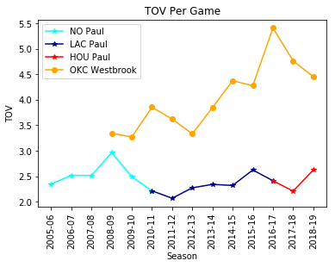
Analysis per seasons
TOV: Turn-over
- Paul is declining in Assists whereas Westbrook is improving
- Paul protects the ball better than Westbrook (High TOV is bad)

Slide 6
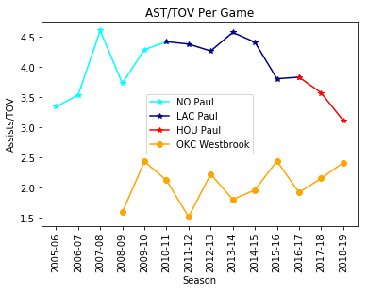
Analysis per seasons
TOV: Turn-over
AST: Assist
- Paul has clearly shown the ability to protect the ball and prevent turn-overs at the point guard position.
- Westbrook has been slowly improving, this is not his strong suit.

Slide 7
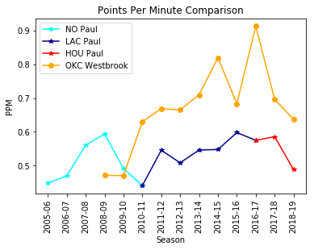
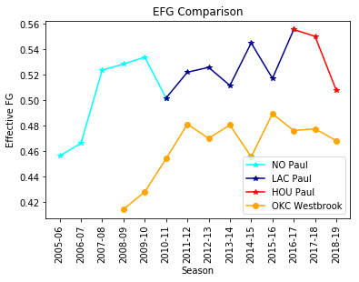
Analysis per seasons
- Westbrook is a more prolific scorer
- Paul is a more accurate shooter

Slide 8
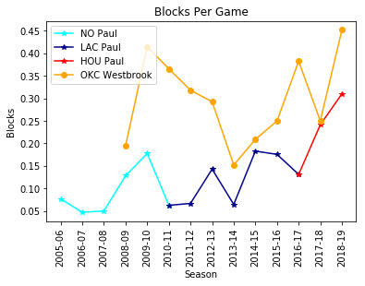
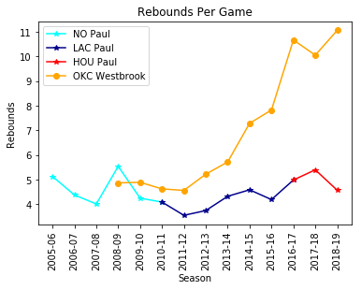
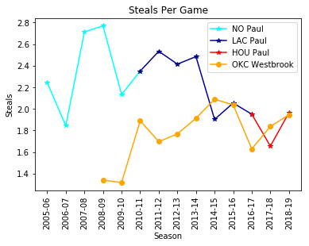
Analysis per seasons
Westbrook outperforms Paul in blocks and rebounds.
Paul has been able to accumulate more steals over his career. However they were tied at the age of 30

Slide 9
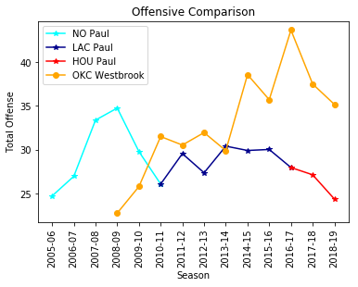
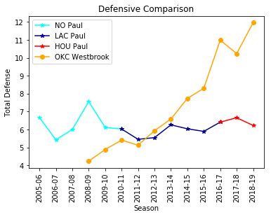
Offensive and defensive comparison
Statistically on Offensive and Defensive indicators, Westbrook has surpassed Paul

Slide 10
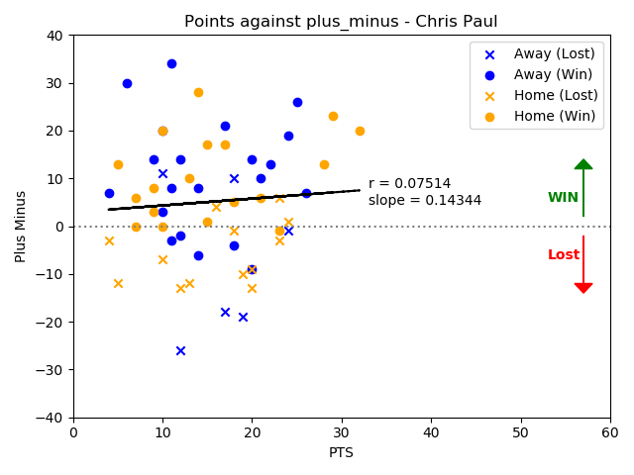
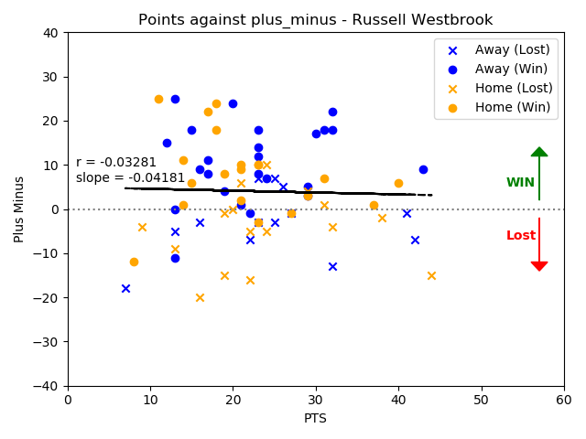
Points and plus-Minus for last season
Plus-Minus (PM) reflects how the team did while that player is on the court
-> High PM: player performed well
C. Paul was consistent.
Positive effect on the team
R. Westbrook was “moodier”.
Negative effect on the team

Slide 11
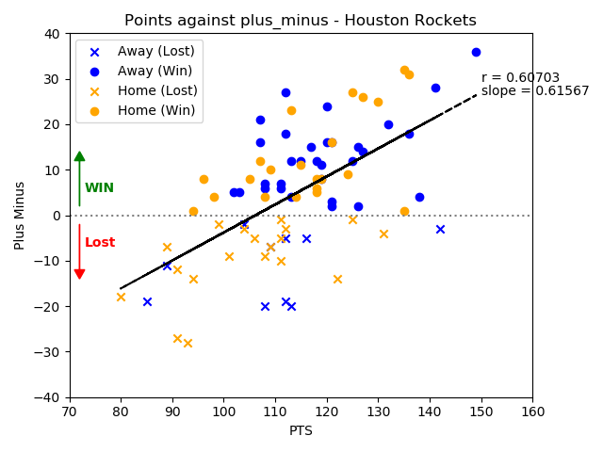
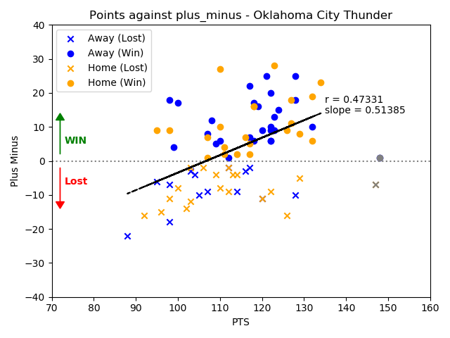
Points and plus-Minus for last season by teams
Removed
outliers
Correlation between points and PM describes better the team performance than the
individual player performance

Slide 12
Conclusion
Westbrook is the best fit for the Rockets at this stage of his career based on the data
At this point, he provides the most value based on his statistics on the offense and defensive side of the ball
He is a more accomplished scorer, rebounder, and provides more opportunities to his teammates through assists.
The statistical analysis shows us that an increase in team points correlates with a higher overall plus/minus. Russell can provide this increase and is an upgrade over Paul. (MK. I don’t see that from my data. Better to change that paragraph)

